Slide 1
Identify and Remediate Credentials with Purview
Blueprint

Slide 2




Identify and Remediate Credentials with Purview
Foundational
Optimized
Strategic
Use Data Explorer: Use Microsoft Purview’s Data Explorer to view already discovered credentials. This tool provides visibility into sensitive data types across Microsoft 365 workloads.
Run On-Demand Classification for SharePoint and OneDrive: This feature allows you to rescan older files and update Content Explorer results. It is now a horizontal capability across Microsoft Purview.
Configure Auto-Labeling: Use service-based auto-labeling to apply sensitivity labels to files containing credentials. This can encrypt content and restrict access.
Use Data Loss Prevention (DLP) for SharePoint and OneDrive: Configure DLP policies to remove external sharing permissions or block access to flagged files.
Leverage Data Lifecycle Management (DLM): Automatically delete files containing credentials after a defined retention period.
Use DLP for Exchange Online: Mails containing credentials are prevented from leaving the organization.
Configure Endpoint DLP: Policies prevent user e.g from pasting credentials or uploading documents containing credentials to websites.
Configure DLP for Teams: Implement policies that detect and block posting credentials in Teams messages.
Run On-Demand Classification for Select Endpoints: Older files can be also be rescanned on Endpoints.
Activities
Outcomes
Discover files with credentials
Clean Existing Credentials
Prevent new Credential Sharing
Effort*
1-2 weeks
2–4 weeks
2-4 weeks
*Suggested efforts should be reviewed into timelines based on your tenant size and organizational complexity

Slide 3
Foundational
Discover files with credentials
Use Data Explorer
Run On-Demand Classification for SharePoint and OneDrive

Slide 4
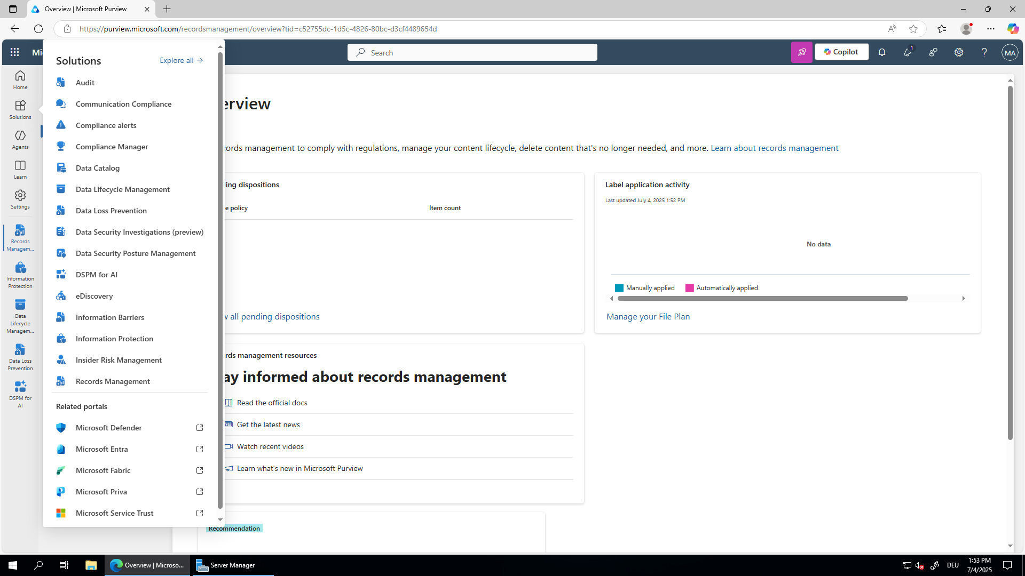
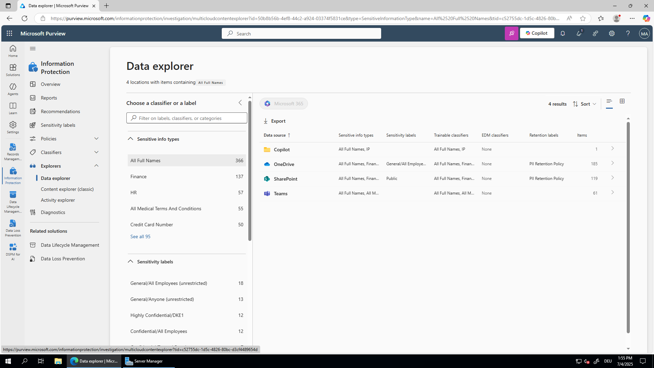
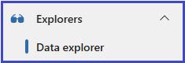
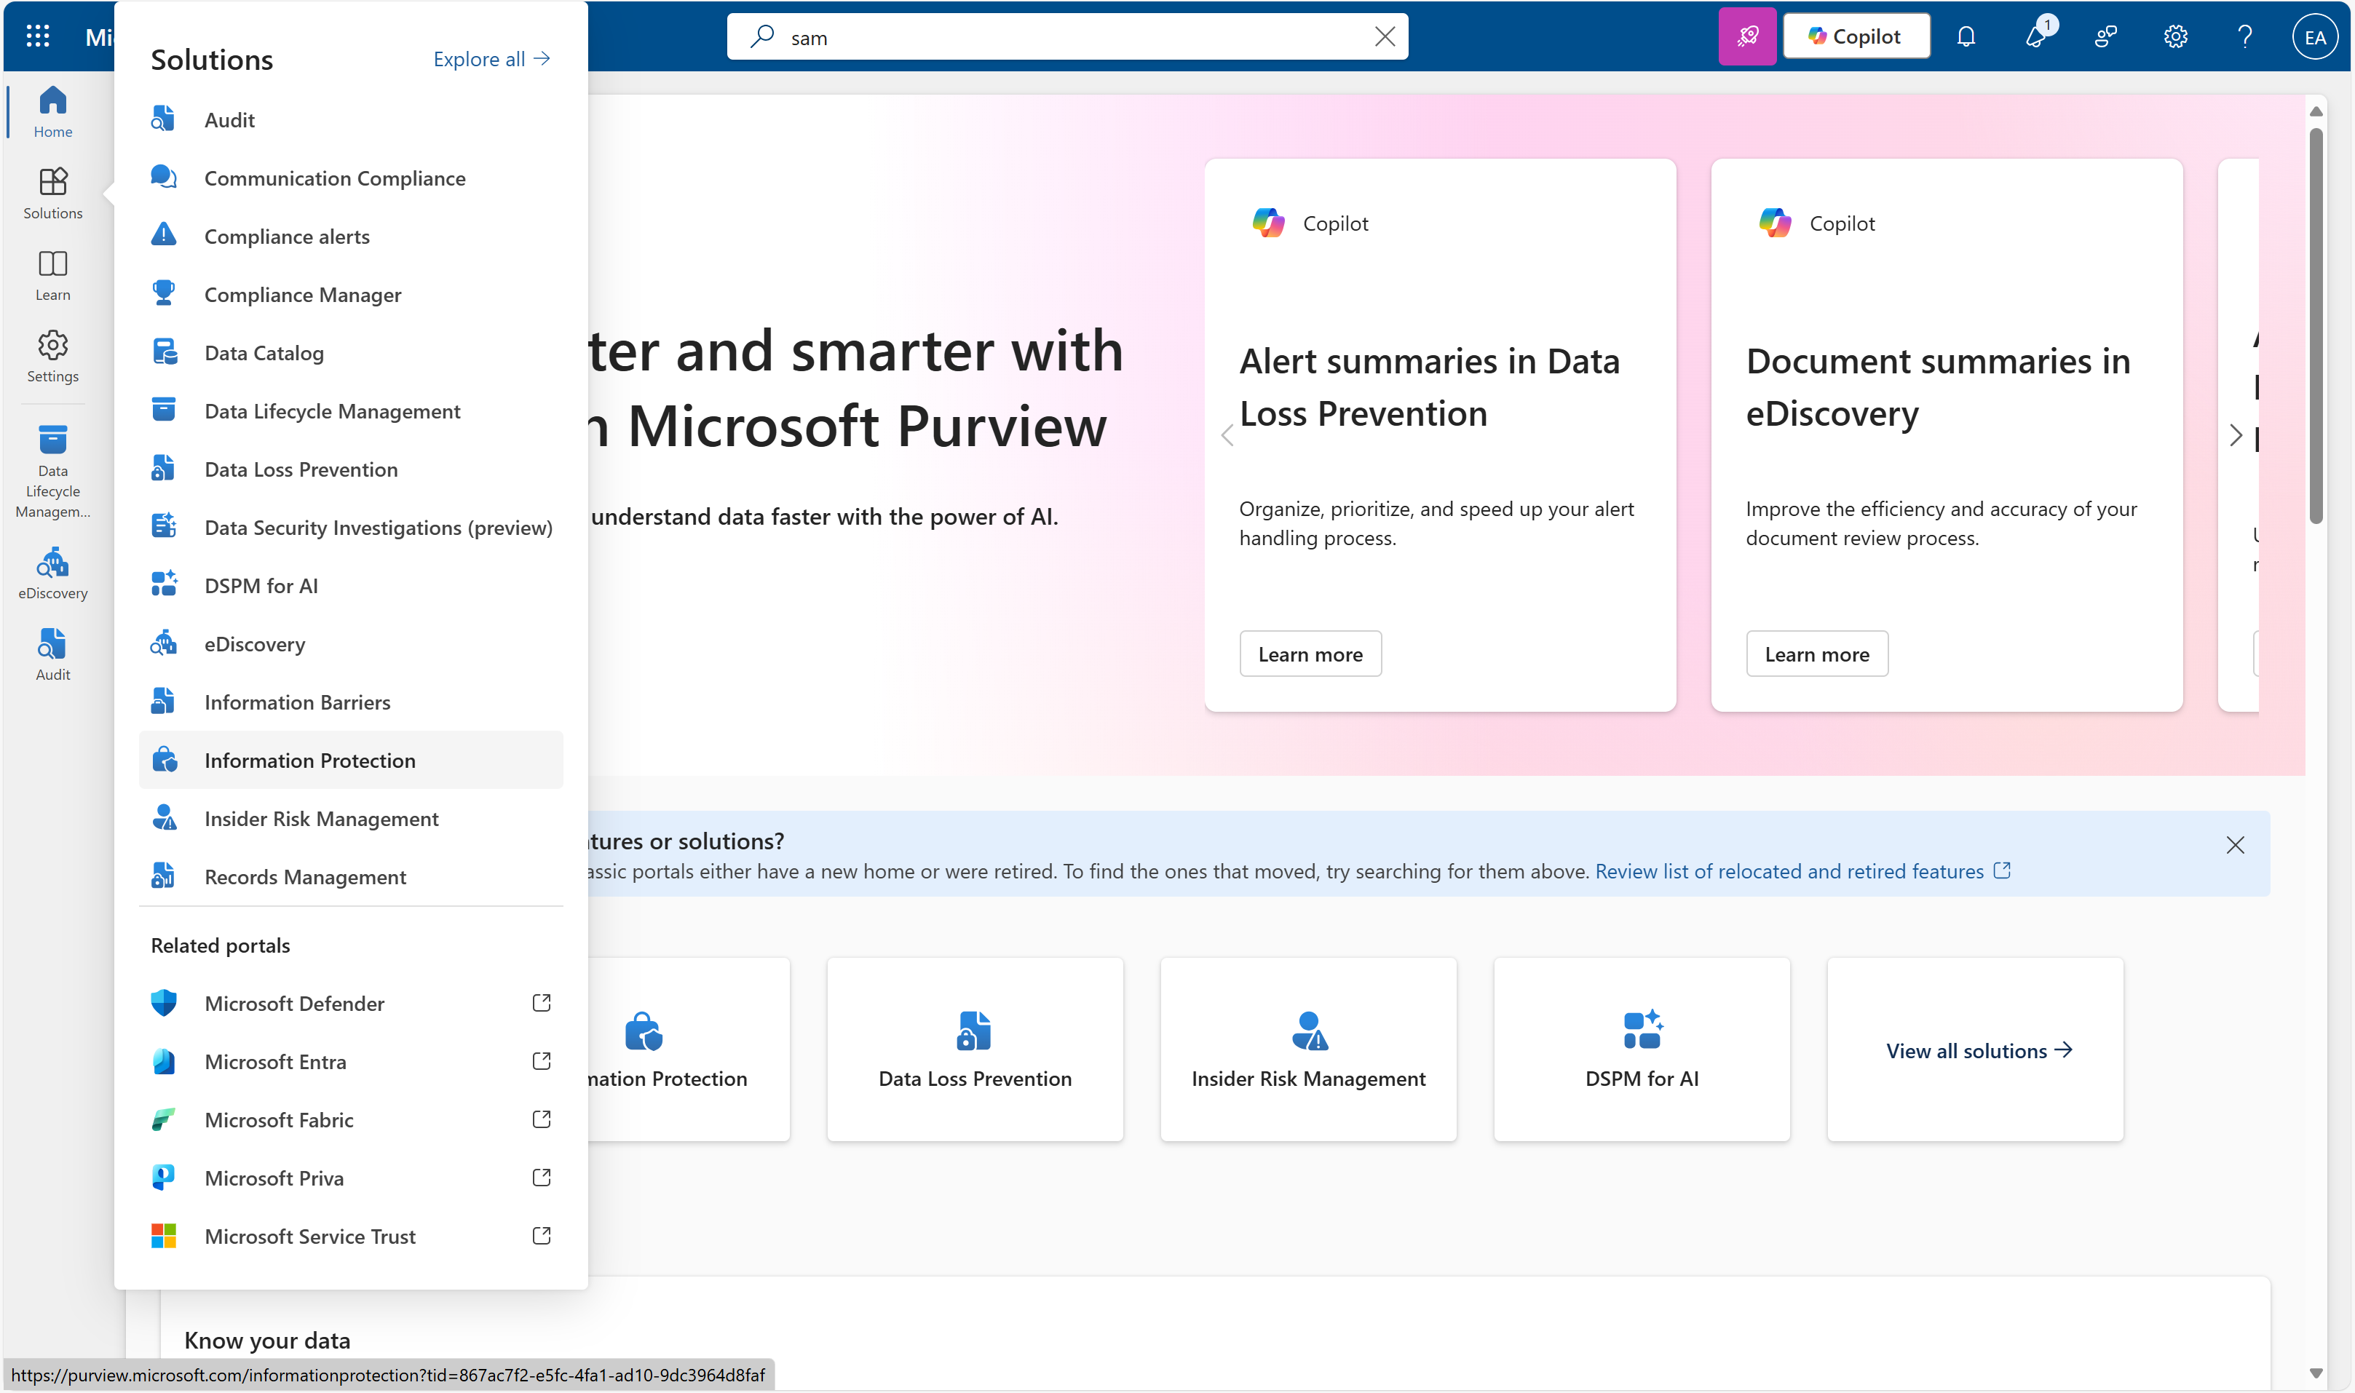
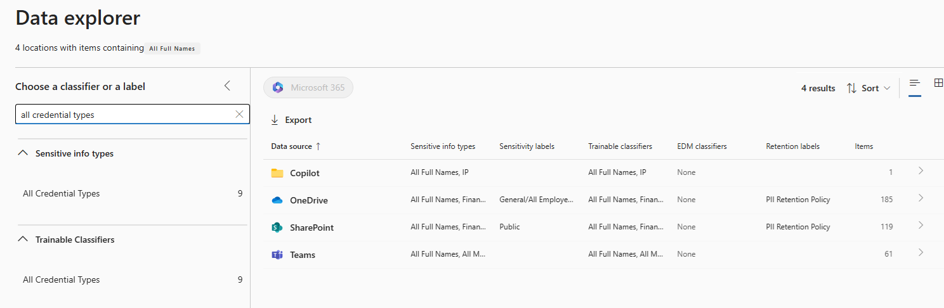
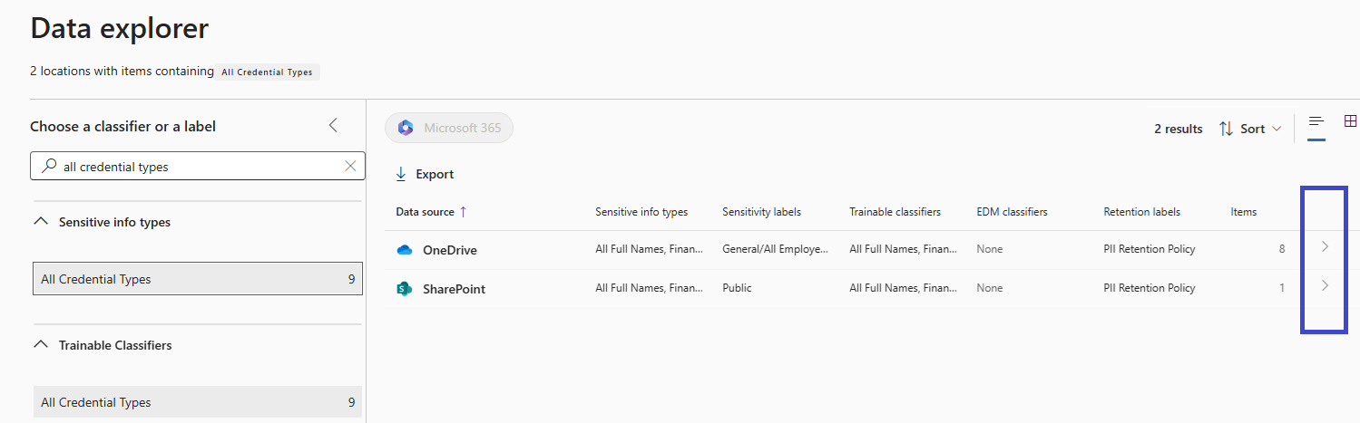
Identify and Remediate Credentials
Use Data Explorer
Use Microsoft Purview’s Data Explorer to search for files containing credentials, using the “All Credential Types” classifier. You will find files across Microsoft 365 workloads SharePoint/OneDrive and Exchange Online.
1
2
3
Available with IPG E5 or above
How to do it
Go to purview.microsoft.com
Go to Solutions > Information Protection
4
5
Select Explorers > Data Explorer
In Choose a Classifier or a label, search and select customer the most suitable Sensitive Information Type for your objective, e.g. All Credential Types
Drill down into locations containing files with credentials on the right-hand side
Learn more on our “Get started with data explorer” page

Slide 5
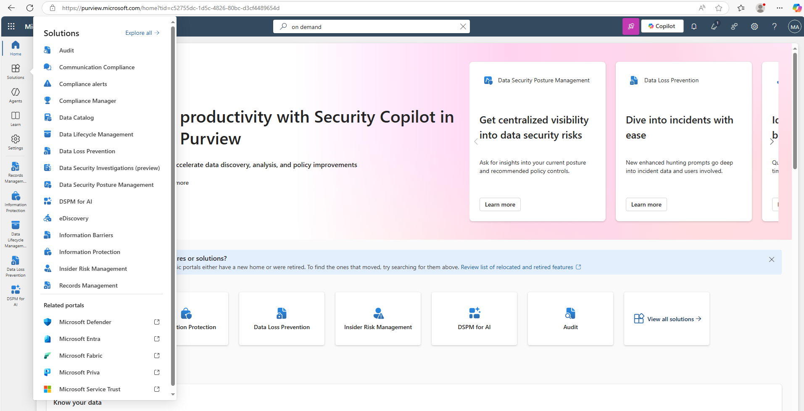
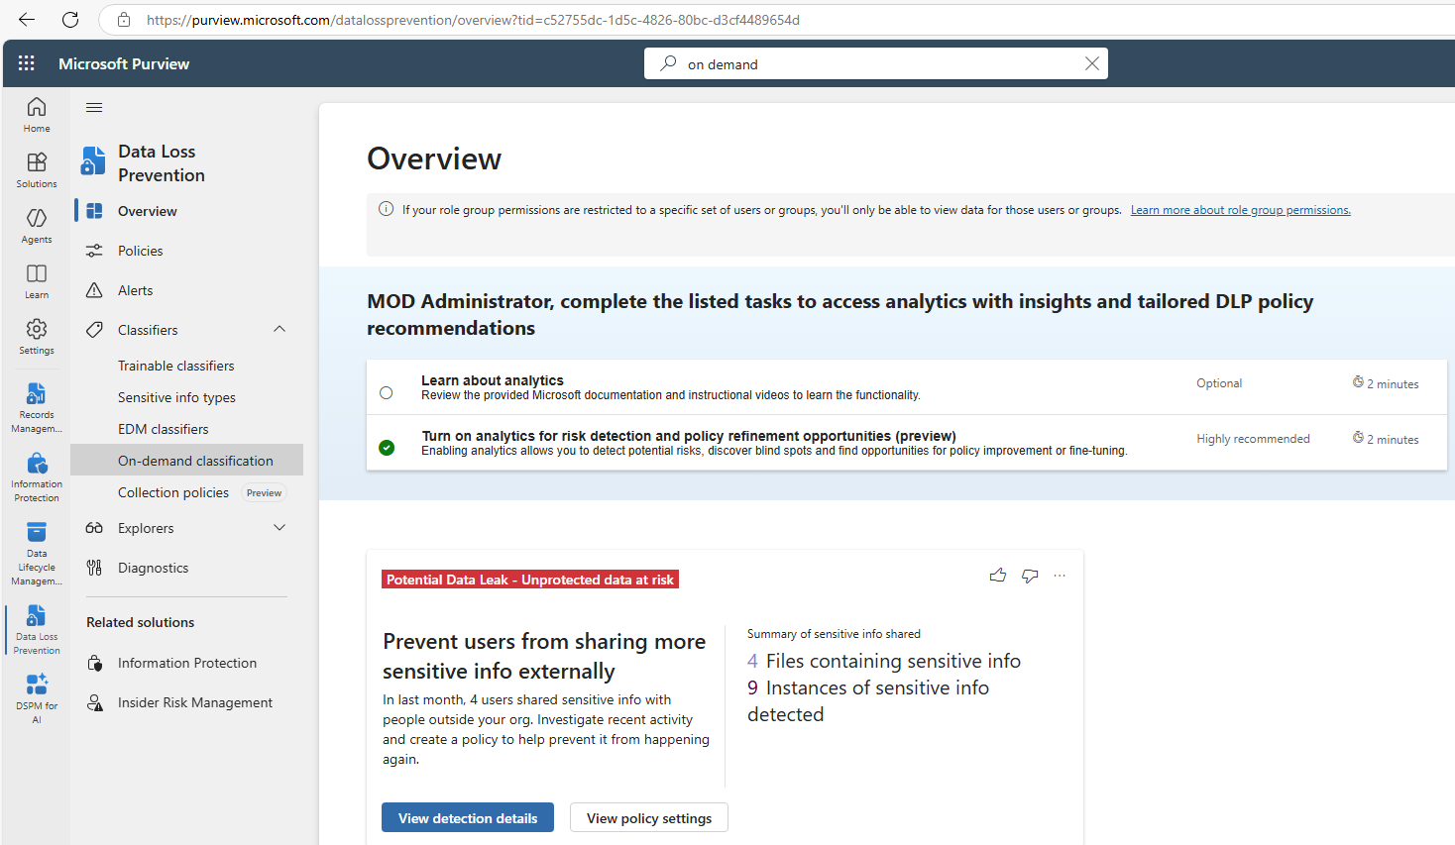
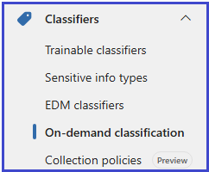

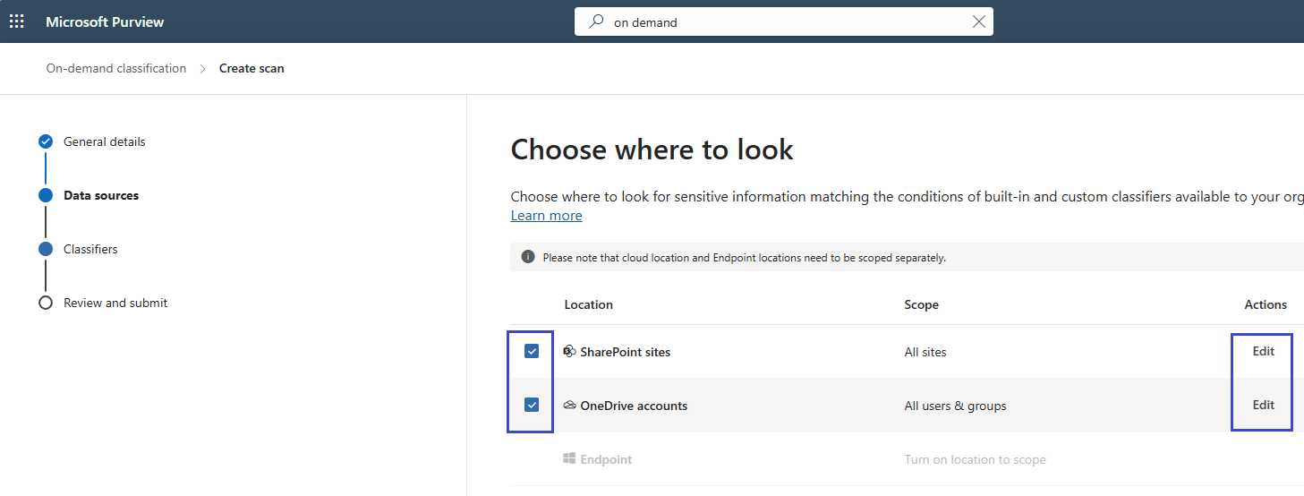
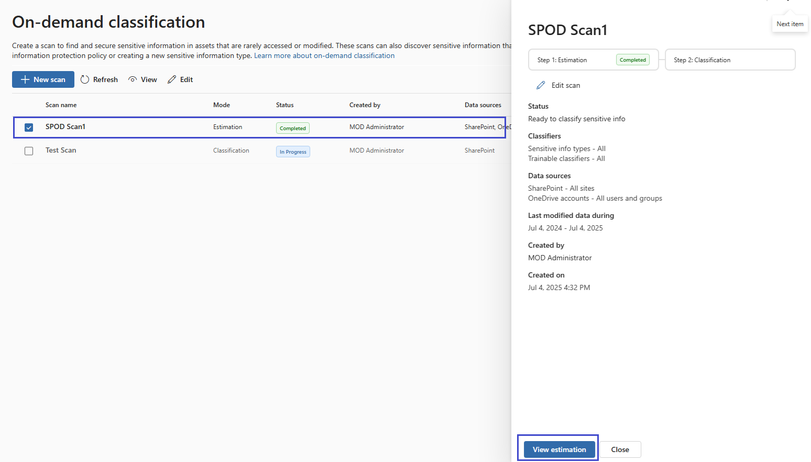
Identify and Remediate Credentials
Run On-Demand Classification for SharePoint and OneDrive
Rescan files on SharePoint and OneDrive that have been uploaded/updated before the credential SIT was introduced to ensure Data Explorer shows the right set ot SITs in the results. On demand-classification for SharePoint and OneDrive requires an Azure subscription and incurs additional costs.
1
2
3
Available with IPG E5, Compliance E5 or M365 E5, needs Azure subscription
How to do it
Go to purview.microsoft.com
Go to Solutions > Data Loss Prevention
4
5
6
Select Classifiers > On-demand classification
Walk through the wizard and make sure you select SharePoint sites and/or OneDrive accounts. Clicking on Edit allows you to limit the scan to specific SharePoint sites and OneDrive accounts
Wait for the estimation to finish
Select a scan with completed estimation, press View Estimation and on the next screen, select Start Classification
Learn more on our “On-demand classification” page

Slide 6
Optimized
Clean Existing Credentials
Use Auto-Labeling on files with credentials
Remove external sharing permissions with DLP for SharePoint and OneDrive
Delete files with credentials using Data Lifecycle Management

Slide 7
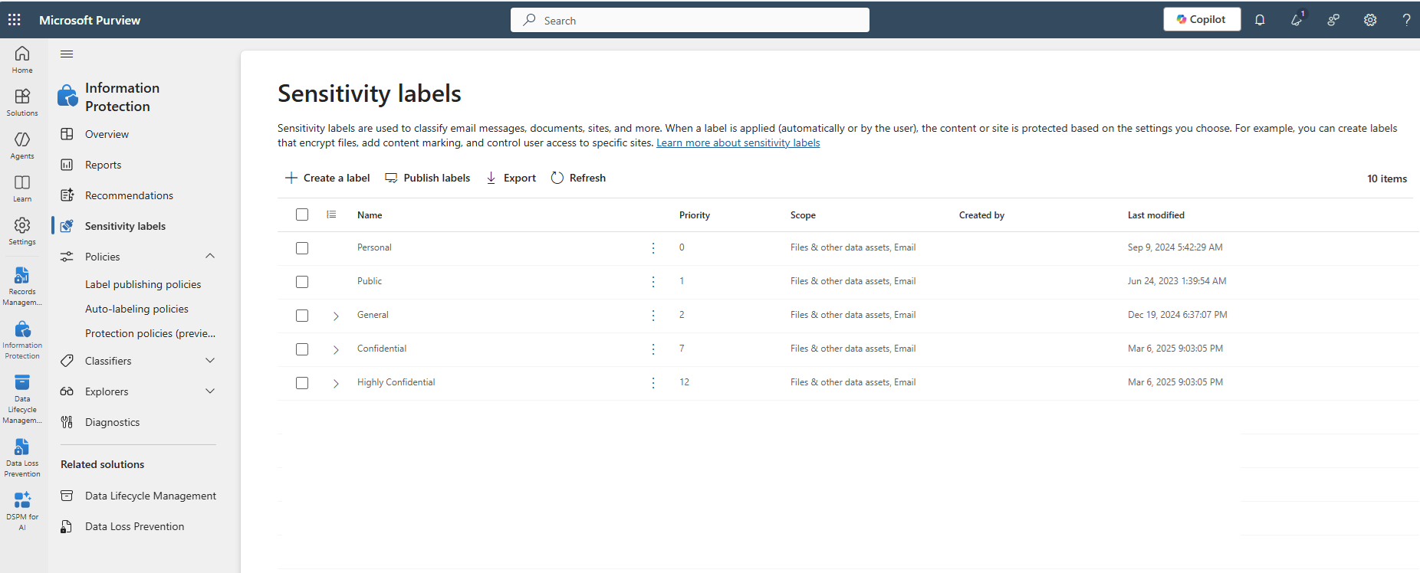
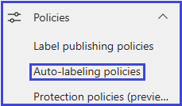
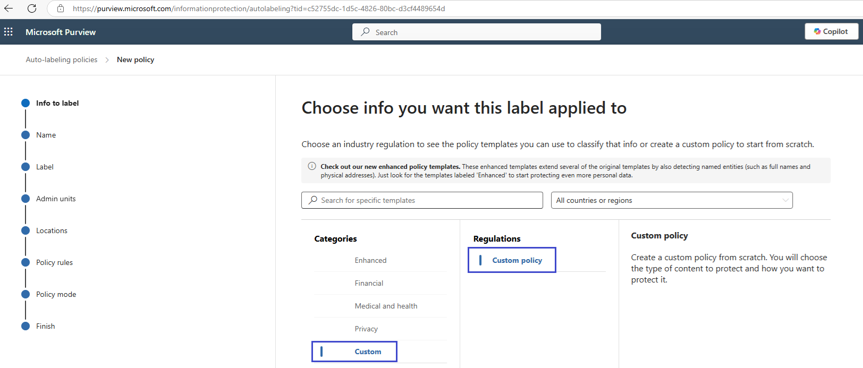
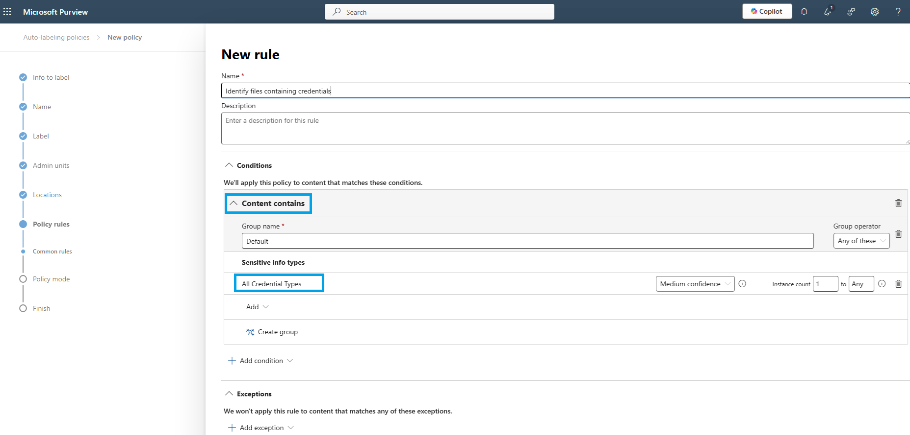
Identify and Remediate Credentials
Use Auto-Labeling on files with credentials
Apply sensitivity labels on files containing credentials using service-based auto-labeling. Labels allow encrypting content and restricting access.
1
2
3
Available with IPG E5, Compliance E5 or M365 E5
How to do it
Go to purview.microsoft.com
Go to Solutions > Information Protection
4
5
6
7
Select Policies > Auto-Labeling Policies
Choose Create auto-labeling policy
Choose Custom and Custom Policy on the first page of the wizard.
Walking through the wizard, choose a name, a suitable label for content with credentials and SharePoint/OneDrive as locations
Create a rule with Content contains selecting Sensitive Info Types, choosing All Credential Types. Save the rule and publish the policy
Learn more on our page “How to configure auto-labeling policies for SharePoint, OneDrive, and Exchange”

Slide 8
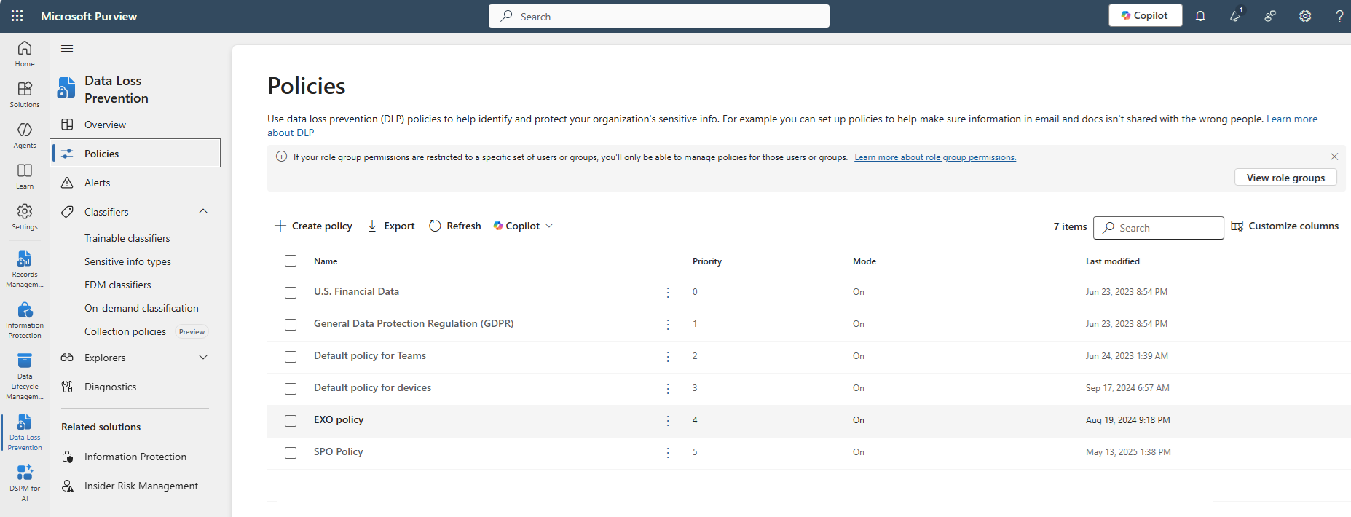

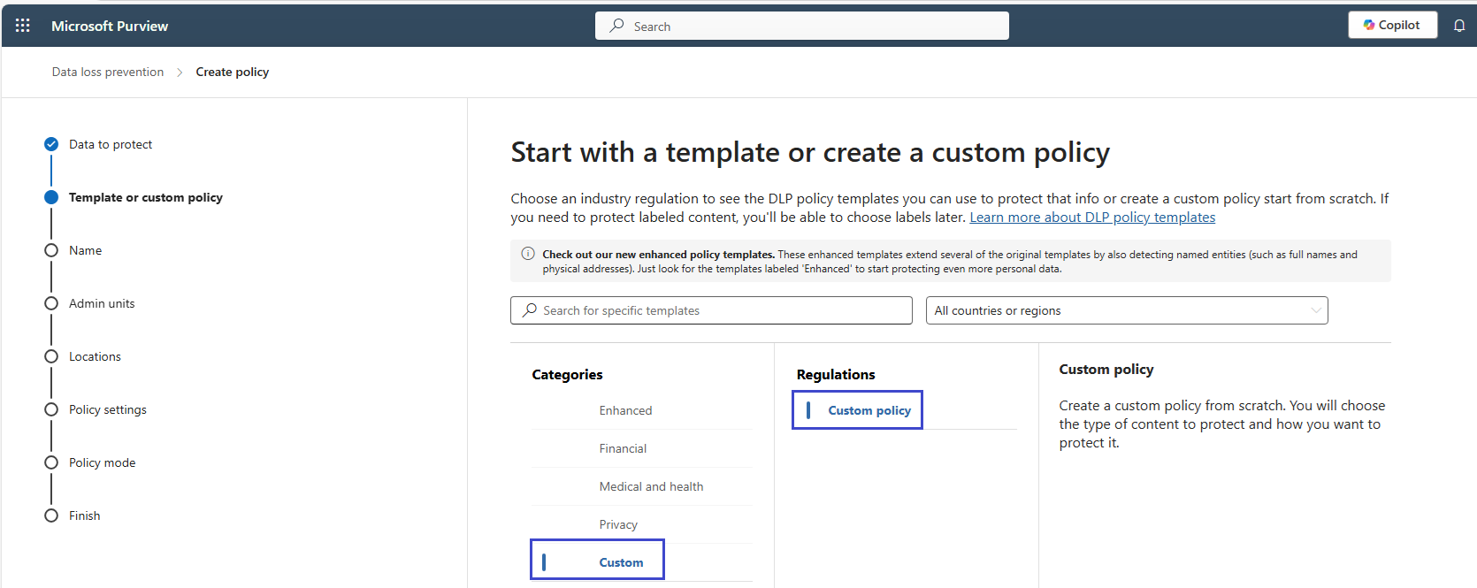
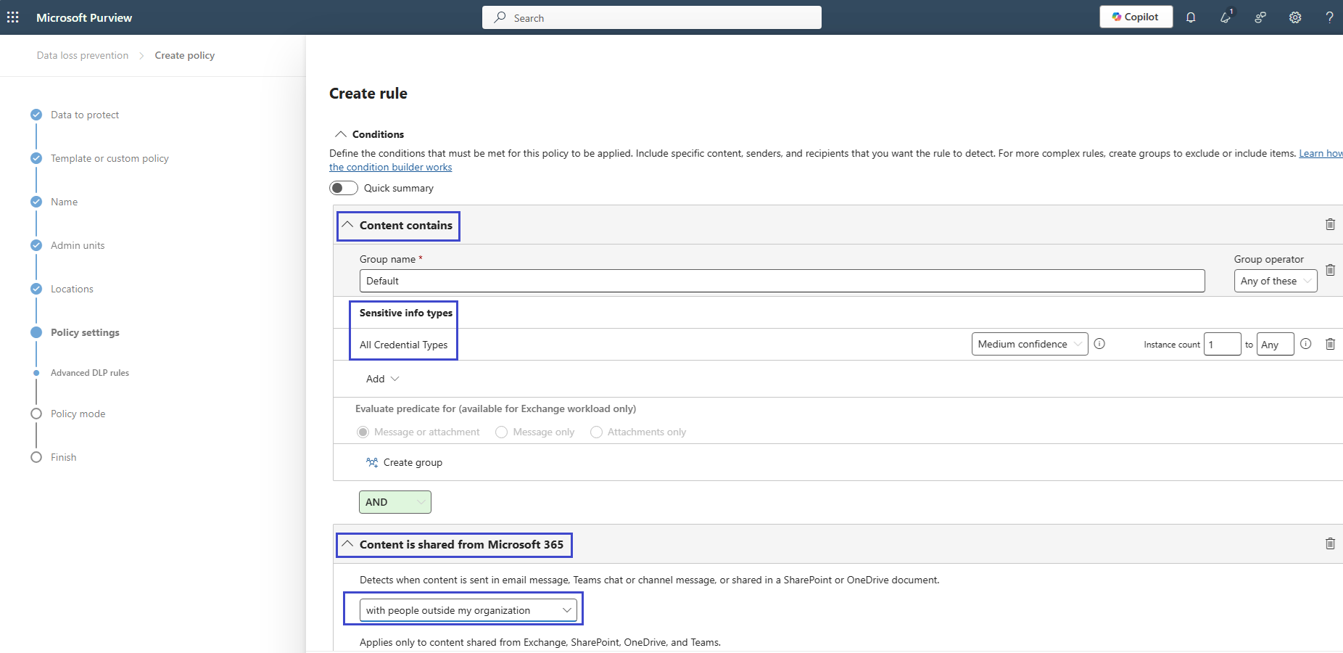
Identify and Remediate Credentials
Remove external sharing permissions with DLP for SharePoint and OneDrive
Remove external sharing permissions and external access for files containing credentials using DLP policies for SharePoint and OneDrive.
1
2
3
Available with IPG E5, Compliance E5 or M365 E5
How to do it
Go to purview.microsoft.com
Go to Solutions > Data Loss Prevention
Select Policies
4
5
6
Choose Create policy, in the wizard choose Data stored in connected sources, then Custom and Custom policy
Name your policy, choose SharePoint and OneDrive only and create a rule
Add condition Content contains selecting Sensitive Info Types, choosing All Credential Types and condition Content is shared from Microsoft 365 with people outside of my organization. Set action Restrict access or encrypt the content in Microsoft 365 locations

Slide 9
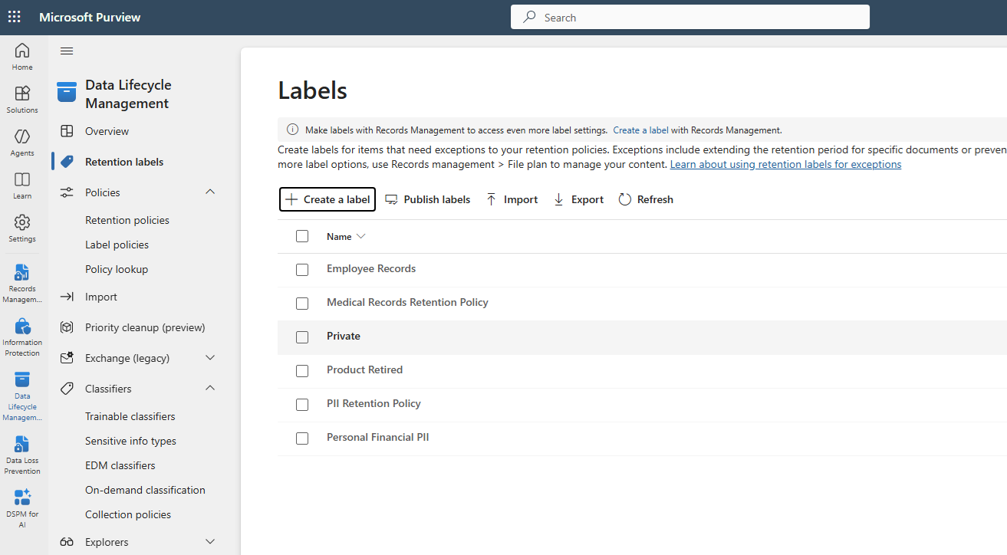
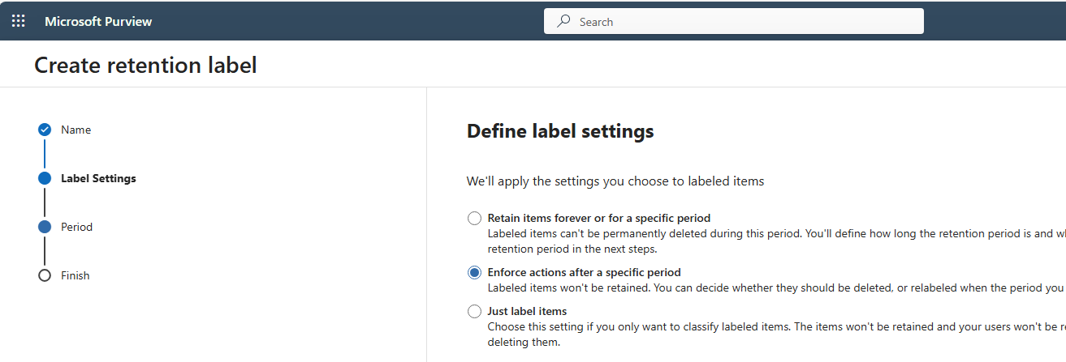
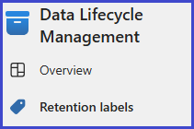
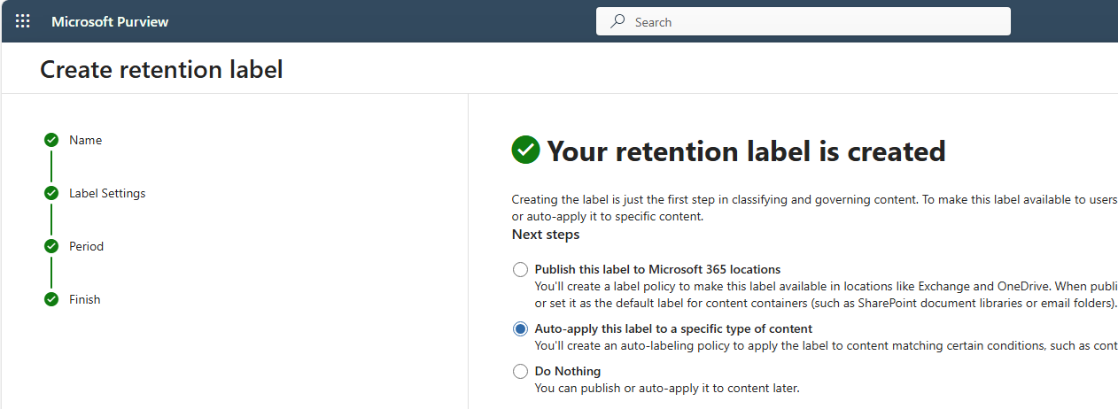
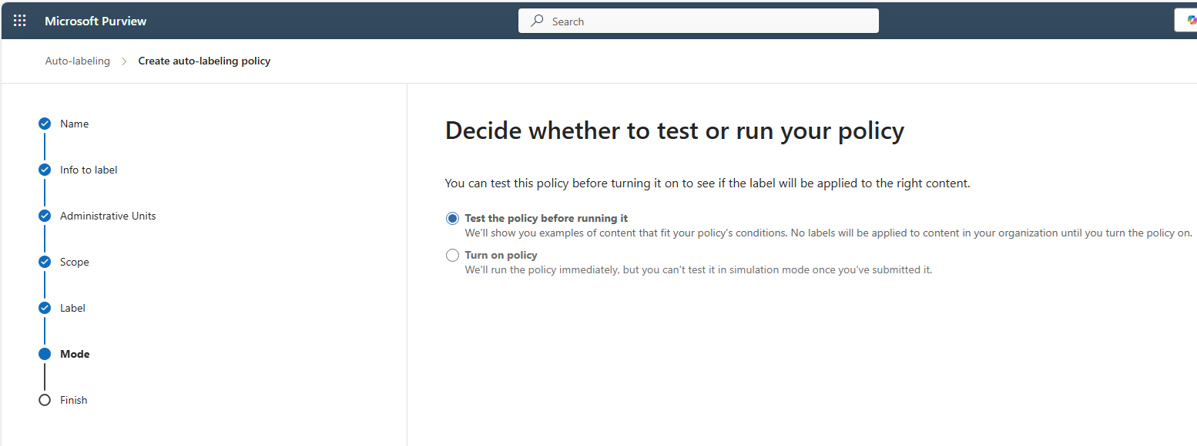
Identify and Remediate Credentials
Delete files with credentials using Data Lifecycle Management
Automatically delete files and emails containing credentials after a defined retention period. Consider using the Priority Cleanup, if data needs to be deleted urgently in Exchange Online.
1
2
3
Available with IPG E5, Compliance E5 or M365 E5
How to do it
Go to purview.microsoft.com
Go to Solutions > Data Lifecycle Management and select Retention Labels
4
5
In the wizard, provide a name and select Enforce action after a specific period. Define 7 days after items were labeled and action Delete item automatically
Select Auto-apply this label to a specific type of content. Select Apply label to content with specific sensitive info. Choose a custom policy, select SIT All Credential Types with High confidence
Select a static policy, choose suitable locations that should be covered and make sure you select Test the policy before running it
Learn more on our “Learn about retention policies and retention labels” page

Slide 10
Strategic
Prevent new Credential Sharing
Use DLP for Exchange Online
Create DLP policy for Endpoints
Configure DLP for Teams
Run On-Demand Classification on Endpoints

Slide 11
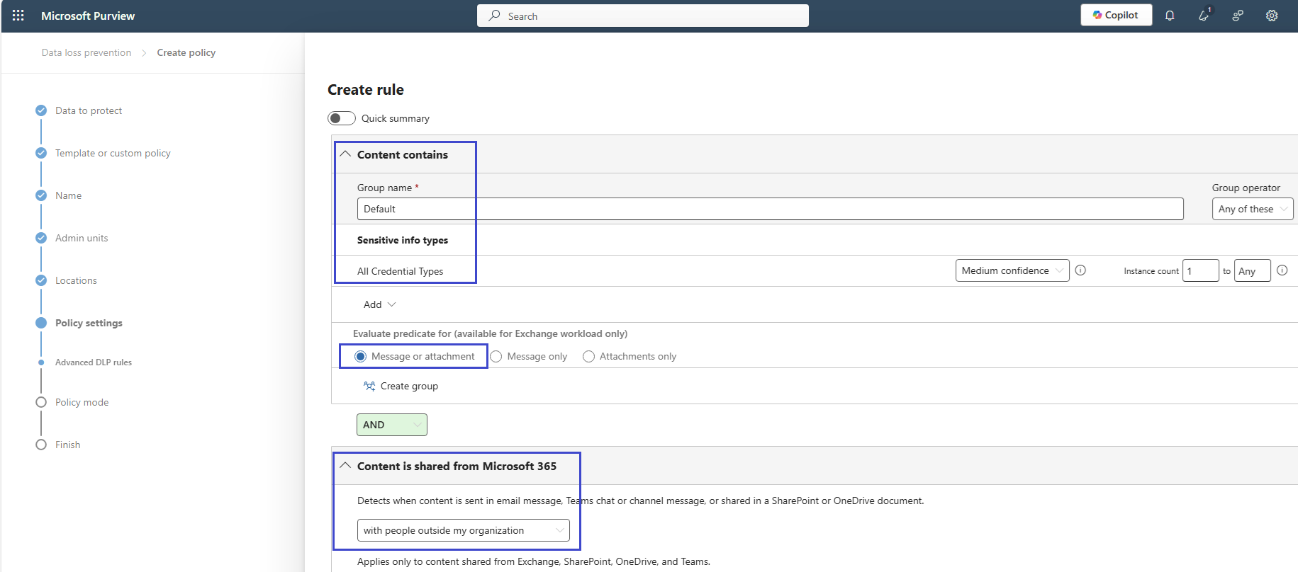
Identify and Remediate Credentials
Use Data Loss Prevention (DLP) for Exchange Online
Prevent sending mails containing credentials to external recipients using DLP policies for Exchange Online. Customers should establish an exception process which e.g. allows sending credentials to new hires or close partners.
1
2
3
Available with IPG E5, Compliance E5 or M365 E5
How to do it
Go to purview.microsoft.com
Go to Solutions > Data Loss Prevention
Select Policies
4
5
6
Choose Create policy, in the wizard choose Data stored in connected sources, then Custom and Custom policy
Name your policy, choose Exchange mail only and create a rule
Add condition Content contains selecting Sensitive Info Types, choosing All Credential Types and condition Content is shared from Microsoft 365 with people outside of my organization. Set action Restrict access or encrypt the content in Microsoft 365 locations
Learn more on our “Data loss prevention Exchange conditions and actions reference” page

Slide 12
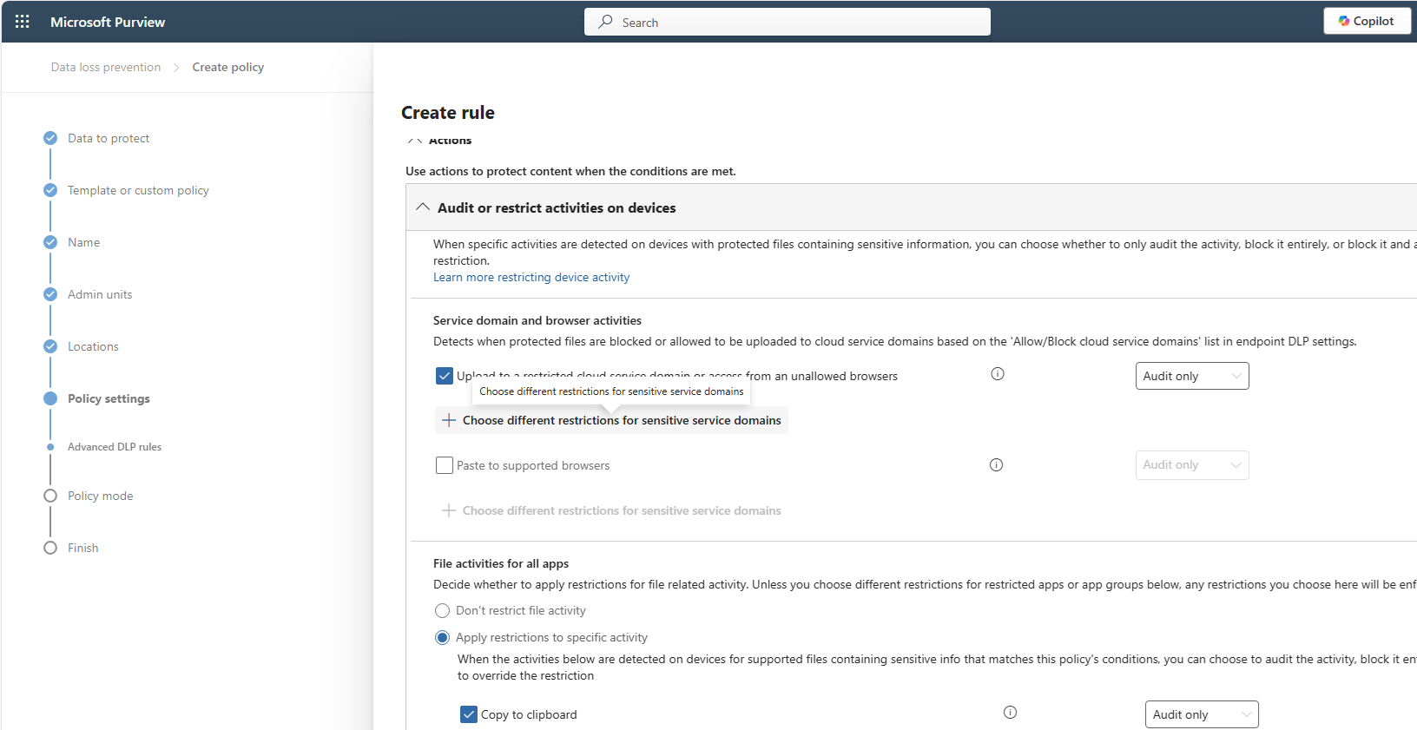
Create DLP policy for Endpoints
Block the sharing of sensitive information
Endpoint DLP helps prevent sensitive data from being copied to USB drives, printed, or uploaded to unapproved apps from organizational devices. This protects data on Windows 10/11 and macOS devices enrolled with Microsoft Purview.
1
2
3
Available with IPG E5, Compliance E5 or M365 E5
How to do it
Go to purview.microsoft.com
Go to Solutions > Data Loss Prevention
4
5
6
Select Policies
Choose Create policy, in the wizard choose Data stored in connected sources, then Custom and Custom policy
Name your policy, choose Devices only and create a rule
Add condition Content contains selecting Sensitive Info Types, choosing All Credential Types and action Audit or restrict activities on devices: block copy to USB, print, clipboard or browser upload
Learn more on our “Get started with endpoint data loss prevention” page

Slide 13
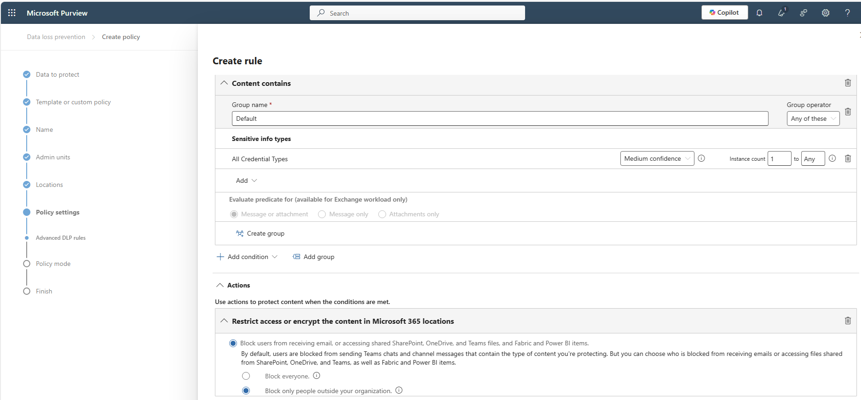
Identify and Remediate Credentials
Configure DLP for Teams
Prevent sending Teams messages containing credentials to external recipients using DLP policies for Teams. (Sending files via Teams is blocked with a SharePoint and OneDrive DLP policy.)
1
2
3
Available with IPG E5, Compliance E5 or M365 E5
How to do it
Go to purview.microsoft.com
Go to Solutions > Data Loss Prevention
Select Policies
4
5
6
Choose Create policy, in the wizard choose Data stored in connected sources, then Custom and Custom policy
Name your policy, choose Teams chat and channel messages only and create a rule
Add condition Content contains selecting Sensitive Info Types, choosing All Credential Types and condition Content is shared from Microsoft 365 with people outside of my organization. Set action Restrict access or encrypt the content in Microsoft 365 locations and block only people outside of your organization
Learn more on our “Data loss prevention and Microsoft Teams” page

Slide 14
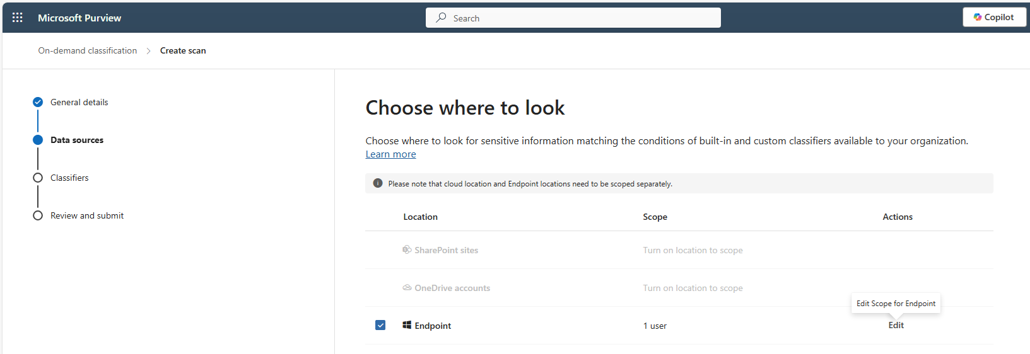
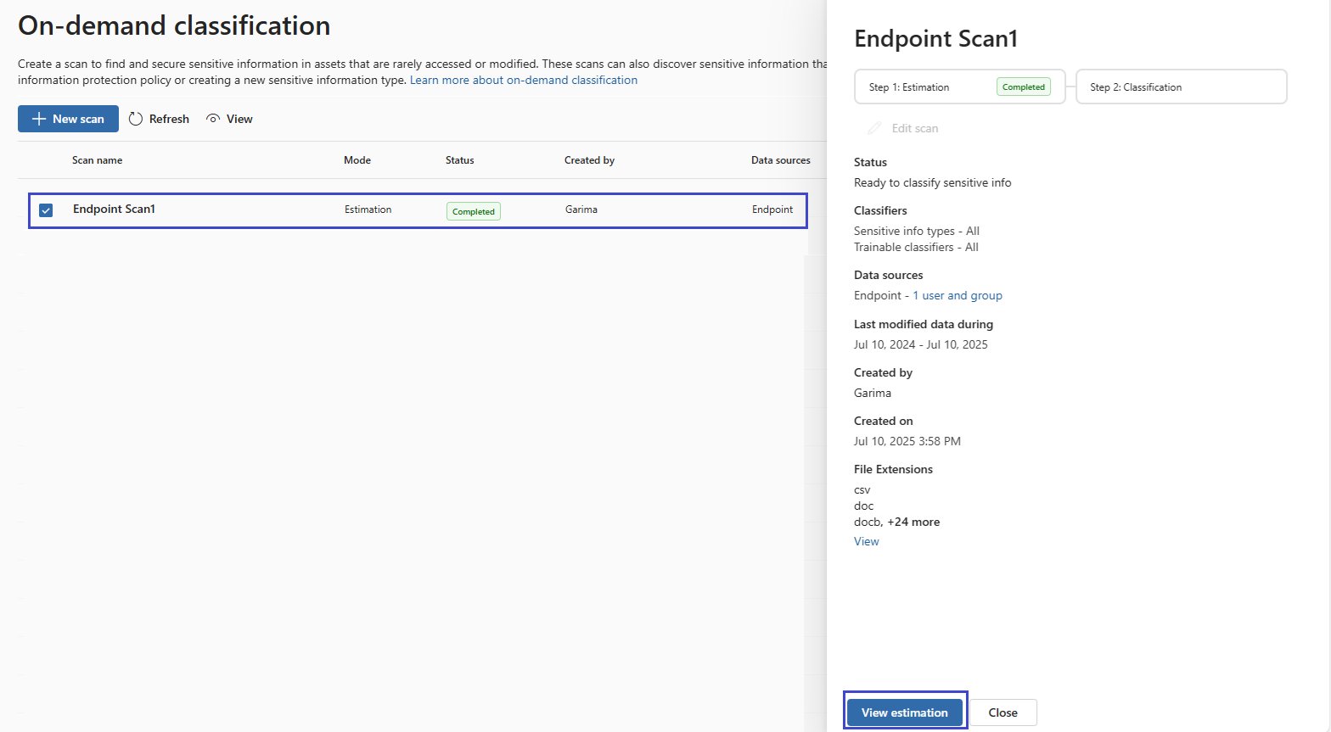
Identify and Remediate Credentials
Run On-Demand Classification for Endpoints
Rescan files on Endpoints that have been created/updated before the credential SIT was introduced to ensure Data Explorer shows the right set ot sensitive information types in the results. On demand-classification for endpoints requires an Azure subscription and incurs additional costs.
1
2
3
Available with IPG E5, Compliance E5 or M365 E5, needs Azure subscription
How to do it
Go to purview.microsoft.com
Go to Solutions > Data Loss Prevention
4
5
6
Select Classifiers > On-demand classification
Walk through the wizard and make sure you select only Endpoint. Click on Edit to select the users/groups in scope for the scan
Wait for the estimation to finish
Select a scan with completed estimation, press View Estimation and on the next screen, select Start Classification
Learn more on our “On-demand classification” page

